Slide 1
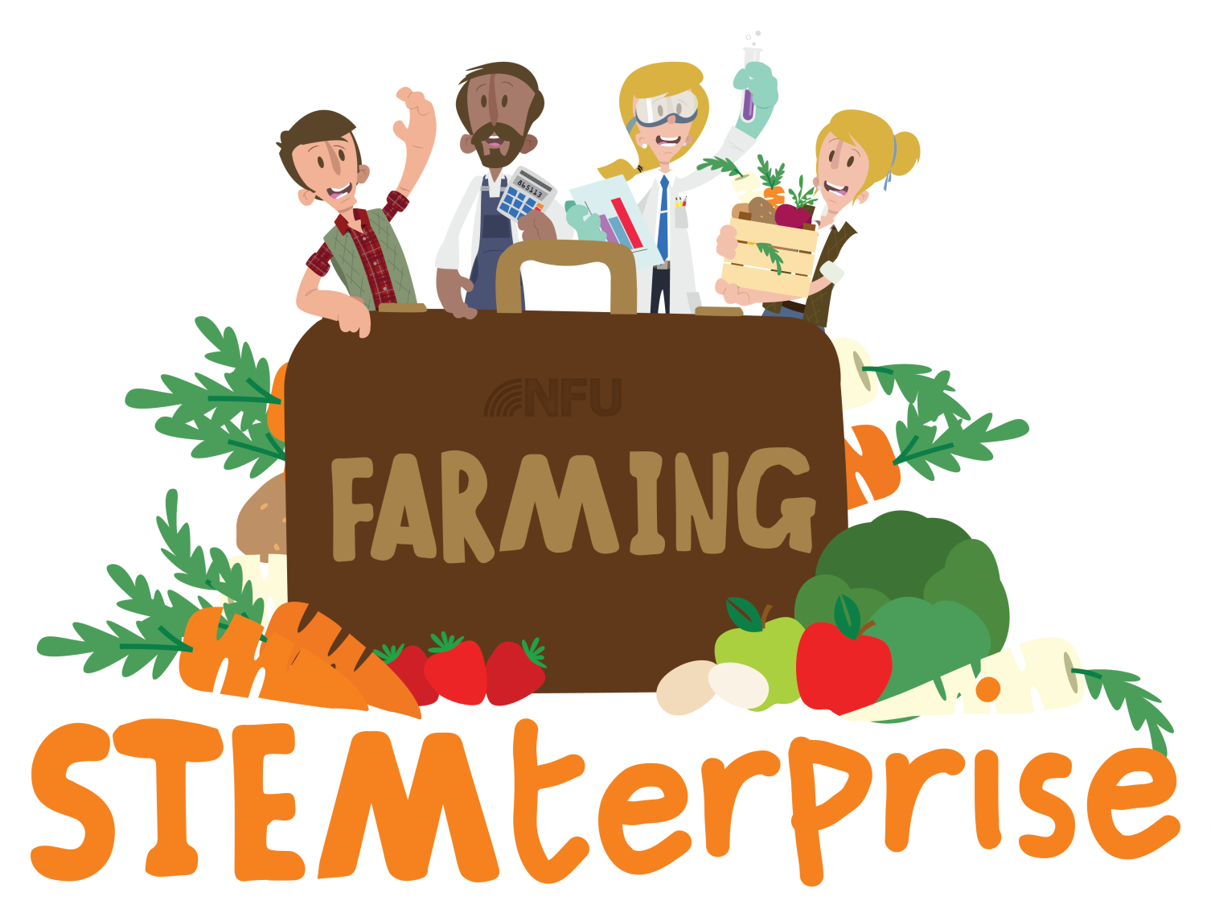
Stage 3: Designing a healthy food product

Slide 2
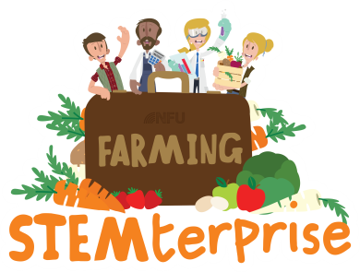
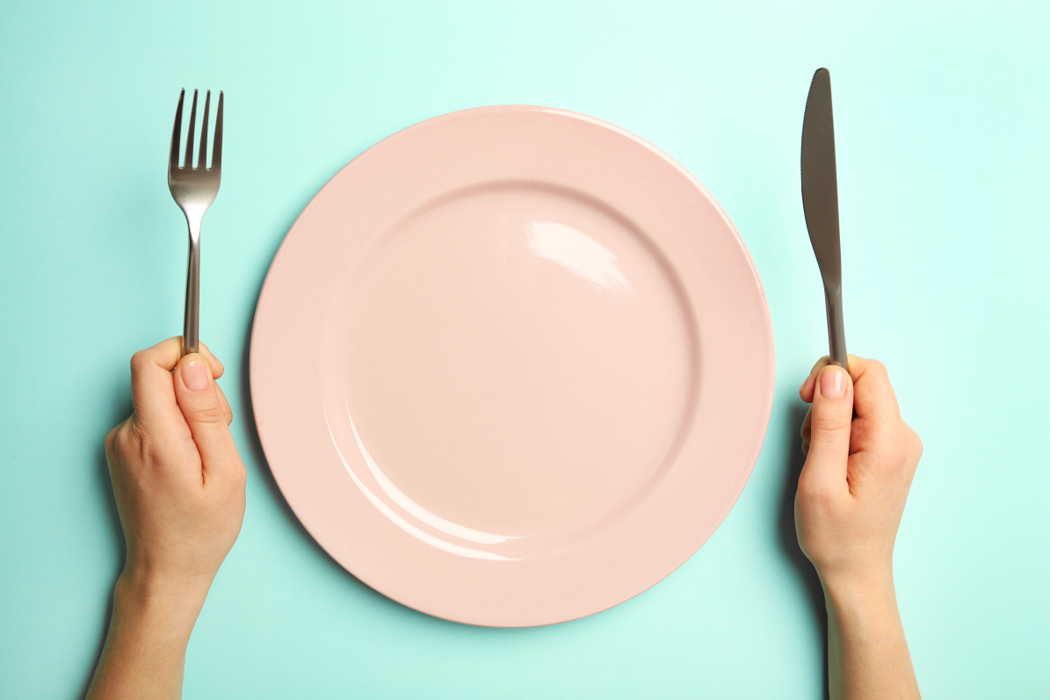
Talk to your partner
What can you remember about healthy eating? What sorts of food do we need to include in our diet to stay healthy?

Slide 3
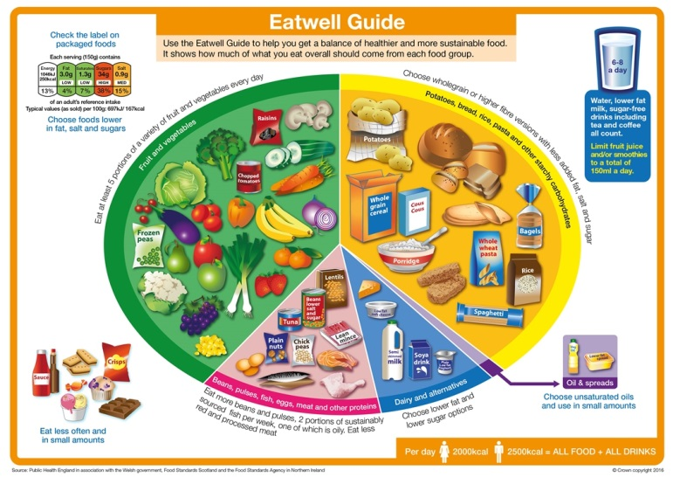
The Eatwell guide
The healthy eating model for the UK is called the Eatwell Guide.
Notes:
More resources at www.foodafactoflife.co.uk

Slide 4
The Eatwell guide
We should choose a variety of different foods from each food group to help our bodies get everything they needs to stay healthy.

Slide 5
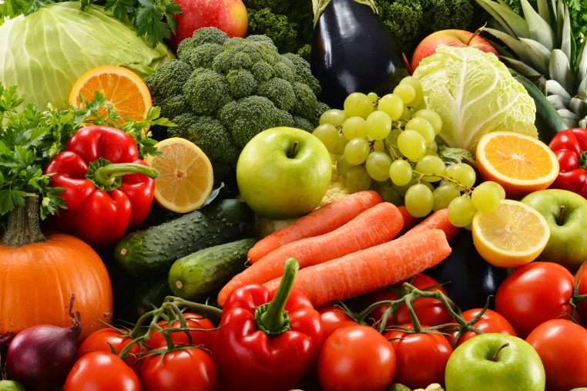
Fruit & Vegetables
We should aim to eat at least five portions of a variety of fruit and vegetables each day.
As a guide, a portion is what fits into the palm of our hand.
Choose from fresh, frozen, canned, dried or juiced fruit and vegetables.

Slide 6
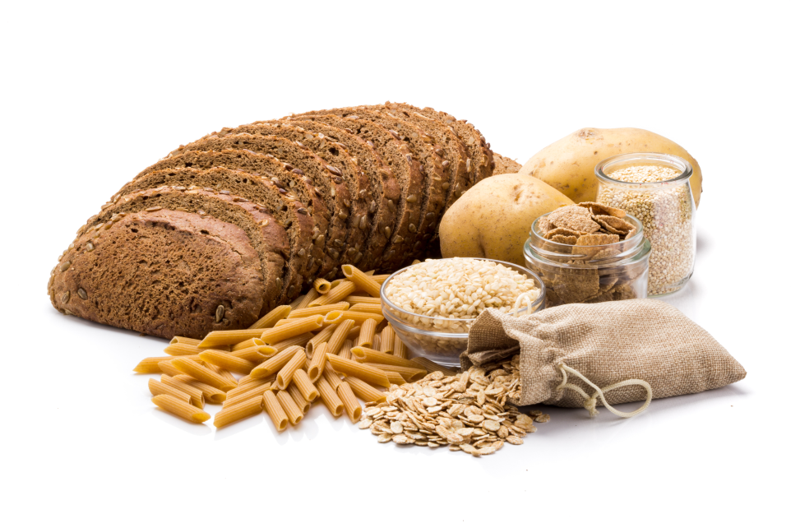
Potatoes, bread, rice, pasta and other starchy carbohydrates
Starchy food should make up just over a third of the food we eat.

Slide 7
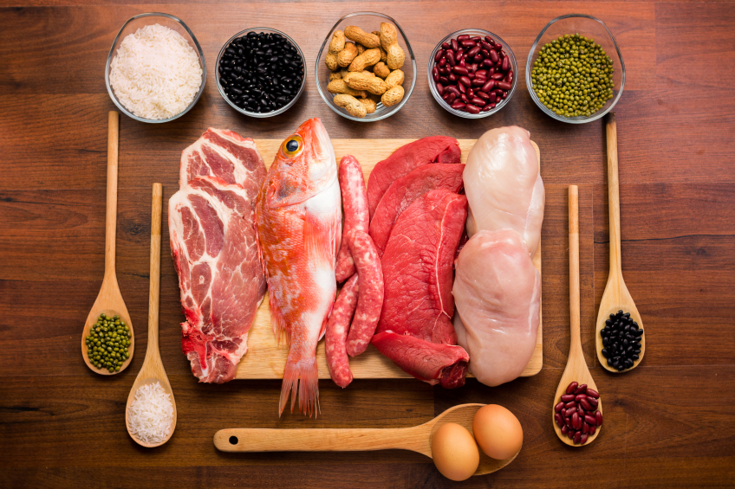
Meat, eggs, beans, pulses and fish
We should eat some foods from this group to give us protein and minerals.

Slide 8
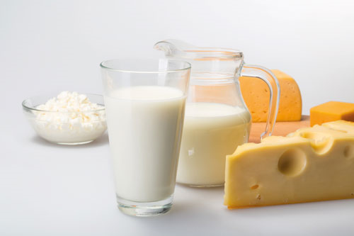
Dairy and alternatives
We should eat some milk and dairy food (or dairy alternatives) such as milk, cheese, yoghurt and fromage frais.
These are good sources of protein and vitamins, and they’re also an important source of calcium, which helps to keep our bones strong.

Slide 9
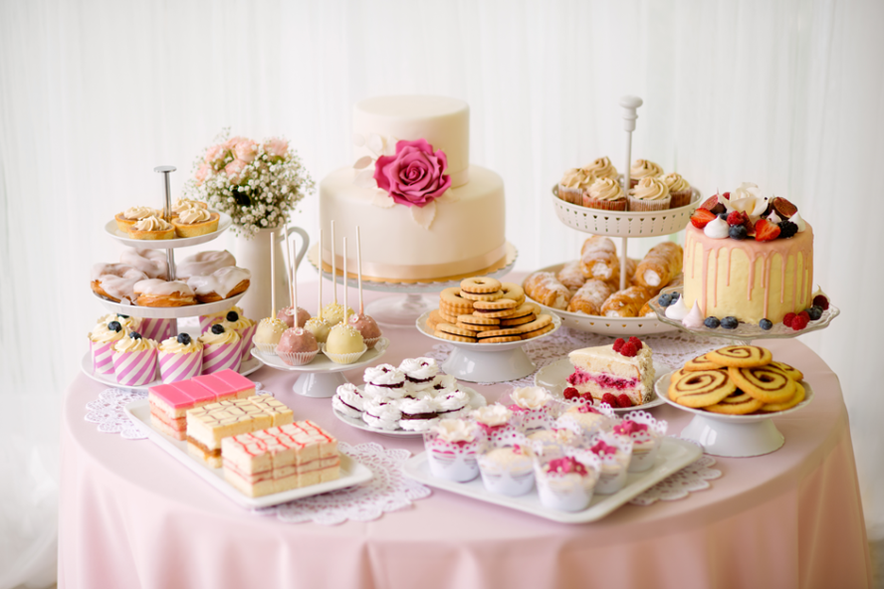
Foods high in fat, salt
and sugars
Foods like chocolate, cakes, biscuits, full-sugar soft drinks, butter and ice-cream are not needed for health.
If foods like these are eaten or drunk, it should only be occasionally and in small amounts.

Slide 10
Your task
You are going to design a British food flag yoghurt to sell in your yoghurt café.
You will use seasonal British fruit to make your yoghurt look like a British flag.

Slide 11
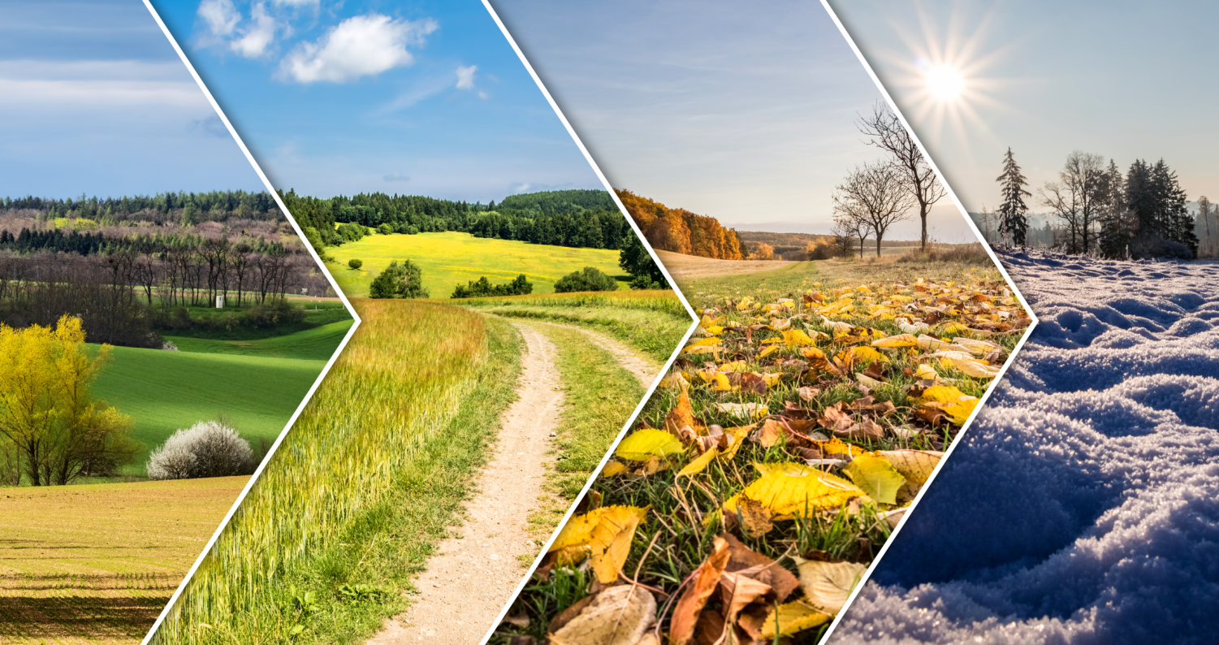
Seasonality
Different fruit and vegetables grow and can be harvested at different times of the year.
Eating foods when they are in season means that we can support British farmers and growers by buying their produce.
If we want to buy food that is not in season in Britain, it has to be imported from other countries. The further our food travels, the more of a negative impact it has on the environment.
Notes:
https://www.countrysideonline.co.uk/back-british-farming/cook-and-eat/the-great-british-larder/

Slide 12
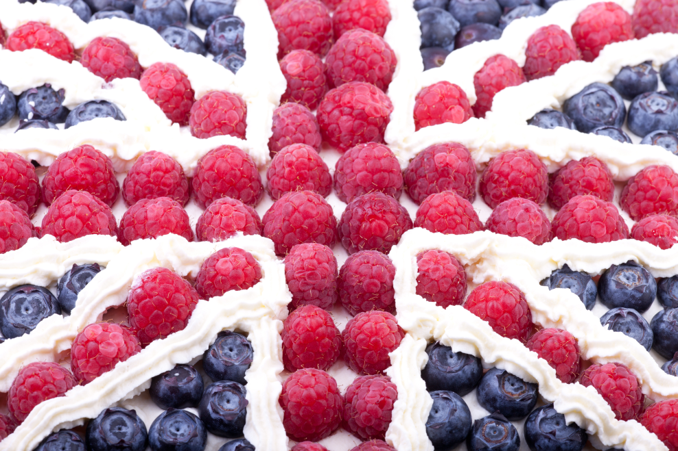
Food flag yoghurt planning

Slide 13
Shopping lists
Write a shopping list of your group’s chosen fruit ingredients.

